Slide 1
Recommendations for a post- pandemic room rentals market
Om Shirke
Adity Dwivedi
Nikhil Singh

Slide 2
AGENDA:
Objective
Background
Key Findings
Recommendations
Appendix:
Data Attributes
Data Methodology
Data Assumptions

Slide 3
OBJECTIVE:
To perform in-depth analysis in order to improve our understanding of the house renting and accommodation market.
To identify the key areas of interest for consumers to focus resources on strategically to increase revenue.
To provide actionable insights using past data to achieve our shared goal of being completely prepared for the post-pandemic market.

Slide 4
BACKGROUND:
Company revenue has seen a major drop in the past few months amongst the ongoing pandemic.
The number of consumers are predicted to increase, since the restrictions are being listed.
The focus and resources need to be shifted strategically in order to capitalize on this opportunity.

Slide 5
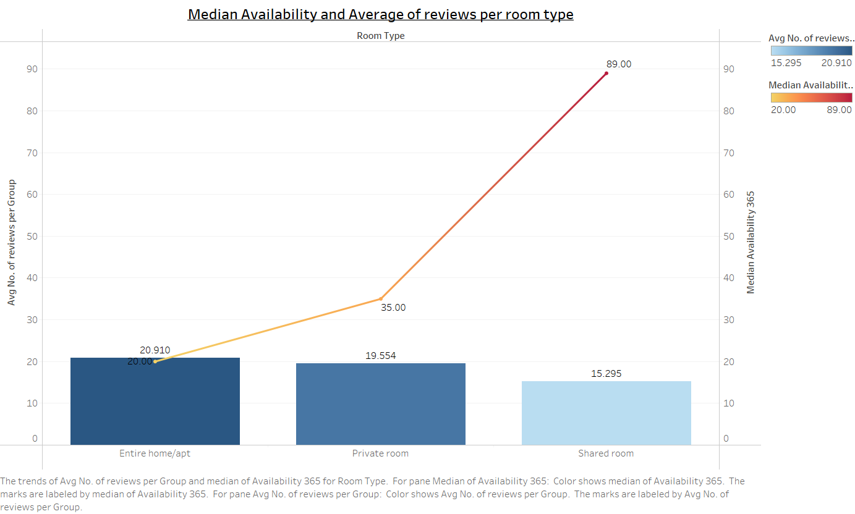
AVAILABILITY OF POPULAR ROOM TYPES:
As the graph shows, the number of reviews per room type is highest for “Entire/apt”. Meaning, this room type is the most popular.(Bar Chart)
At the same time, the median of availability of the same room type out of 365 days is the lowest.(Line Graph)
Here we can observe, there is an almost inverse relationship between the popularity of a room type and it’s availability in a year.

Slide 6
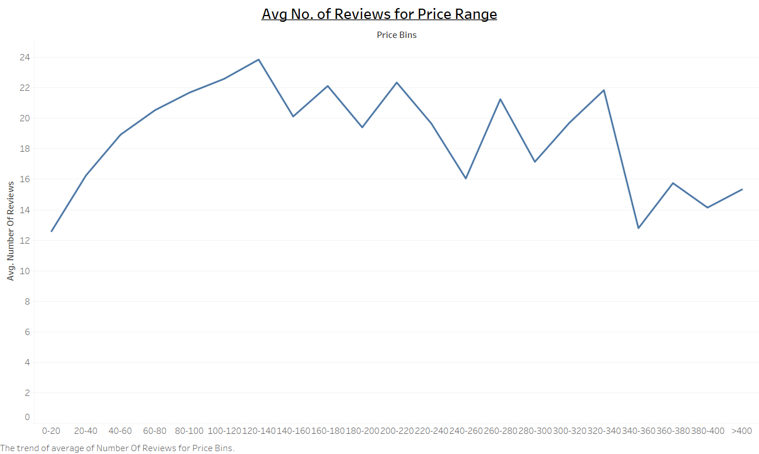
REVIEWS GIVEN FOR DIFFEENT PRICE-RANGE:
The graph describes the trend for the average number of reviews given per price range bin.
We see a near perfect increasing curve in the price range from 0-20$ to 120-140$. Meaning, the consumer satisfaction increases steadily with the increase in cost, up to about 140$.
Any price range above that describes a constantly increasing and decreasing trend.

Slide 7
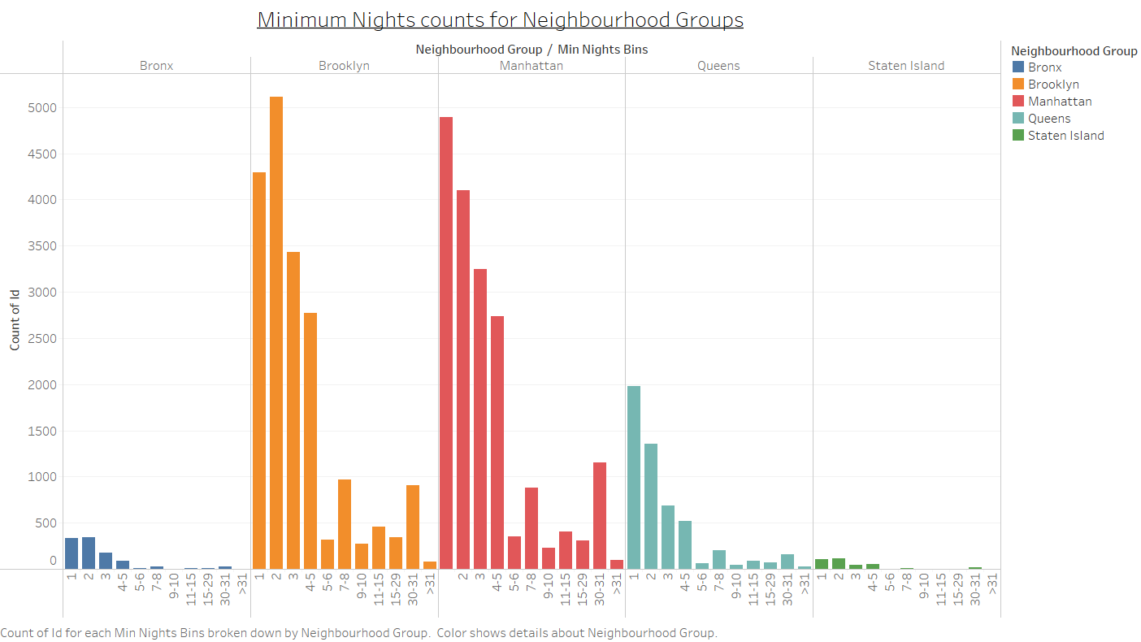
No. OF ROOM RENTALS BASED ON THE No. OF MINIMUM NIGHTS OFFERED IN DIFFERENT NEIGHBOURHOODS:
The number of rooms rented according to the minimum nights offered follows a similar trend over all 5 neighbourhood groups.
The number of rooms rented are highest for minimum nights offered as 1 and 2 days and then go on decreasing as minimum nights increase in each neighbourhood.
We also observe, for each group, there is a small spike again when the minimum nights offered are 30-31. These are perhaps tenants that like to rent an apartment on a monthly basis.

Slide 8
RECOMMENDATIONS:
Try and increase the number of days an entire room/apartment can be rented in a year. As this room type is the most popular, but, the availability throughout the year is quite low in NYC.
Focus on rooms having a price range of 120-140$, since, they are most preferred by consumers.
Focus on and maximize on rooms that offer a minimum stay of 1 and 2 days. Moreover, also try to acquire hosts that are ready to offer rooms for about a month for Tenants.

Slide 9
Appendix: DATA ATTRIBUTES
Here is a snapshot of our data dictionary:
Host listings information like host id, number of listings per host, neighborhood, latitude and longitude.
Consumer preference information like number of reviews , last review.
Available rooms information like room type, minimum nights offered.

Slide 10
Appendix : DATA METHODOLOGY
Used Tableau to create visualizations in order to derive actionable insights:
Detailed methodology is given in the document below:
Data Methodology 1.pdf

Slide 11
Appendix: DATA ASSUMPTIONS:
Null values in a few columns have no material impact on the null hypothesis.
The number of reviews attribute is considered as the popularity measure for consumer preference.
Since, actual reviews were not available (eg: good/bad/moderate), number of reviews was used as based criteria of preference for consumers in visualizations and analysis.

Slide 12
THANK YOU

